Slide 1

Maulana Azad National Institute of Technology, Bhopal
Covid-19 Analysis with Quantile Regression

Slide 2
Vinayak Tiwari 201112011
Pradhuman Mahor 201112039
Manas Mishra 201112442
Amulya Bai Banavath 201112436
Presented by:
Presented to:
Dr. Rajesh Wadhwani

Slide 3
Table of content
Abstract
Analysis /SRS
Data Flow Diagram
Project planning
Tools and Technology used
Steps Involved
1: Analysed Covid dataset
2:Covid data assessment
3:Identified gaps with linear regression
4:Analysed need of quantile regression and implemented it
Modules
Outcome
References

Slide 4
Abstract
Corona viruses are a family of viruses that can cause illnesses such as the common cold, severe acute respiratory syndrome (SARS) and Middle East respiratory syndrome (MERS). In 2019, a new coronavirus was identified as the cause of a disease outbreak that originated in China.
(COVID-19) is an infectious disease caused by the SARS-CoV-2 virus. Most people who fall sick with COVID-19 will experience mild to moderate symptoms and recover without special treatment. However, some will become seriously ill and require medical attention otherwise the results causes them to death.

Slide 5
While the COVID-19 pandemic is affecting all countries, output losses vary considerably across countries. We provide robust determinants of the observed initial output losses using model Quantile Regression Prediction.
Quantile regression is constructed to identify the covariates that affected by the first-wave of COVID-19 mortality rates in the several states of the country considering the local variable affecting the mortality rate of COVID-19.
Quantile regression is used to examine how demographic, socioeconomic, healthcare resources, and behavioral variables are related to the mortality rate of COVID-19 in India. To properly reach that aim, it is chosen regressions that consider the double-bounded characteristic of the mortality rate.

Slide 6
Analysis /SRS
Although Linear Regression provides the prediction of data set of the mortality of COVID-19 under the Linear, Independence, Homoscedastic and Normal data.
As the data is Non linear, Linear Regression conditions get violated which projects the quantile regression terminology for better predictions
Quantile Regression helps to evaluate the non linear data referred in COVID-19 mortality

Slide 7
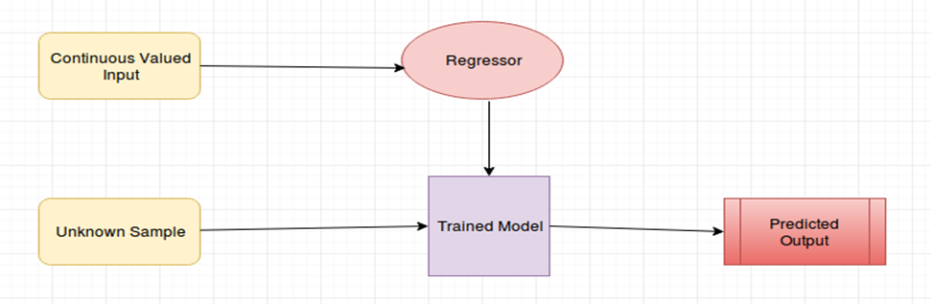
Data Flow Diagram (DFD)
A data flow diagram (DFD) maps out the flow of information for any process or system. It uses defined symbols like rectangles, circles and arrows, plus short text labels, to show data inputs, outputs, storage points and the routes between each destination.

Slide 8
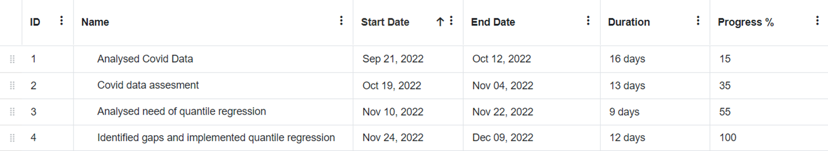
Project Planning (Gantt Chart)

Slide 9


Tools and Technology Used
1.Python :- Python is a high-level, general-purpose programming language that is widely used for a variety of tasks, including web development, data analysis, and scientific computing. It is known for its simplicity, readability, and flexibility, and has a large and active community of users. It is often used in conjunction with other libraries and tools for tasks such as data analysis, machine learning, and web development.
2.Machine Learning :- Machine learning is a field of artificial intelligence that involves the development of algorithms and models that can learn from and make predictions or decisions based on data. It has a wide range of applications, including image and speech recognition, natural language processing, and predictive modeling.

Slide 10


Tools and Technology Used
3.VS Code :- Visual Studio Code (VS Code) is a free, open-source code editor developed by Microsoft. It is a popular choice among developers due to its lightweight design, intuitive interface, and wide range of features. Main features of VS Code include syntax highlighting and code formatting, intelliSense, debugging.
4.Jupyter Notebook :- Jupyter Notebook is a web-based interactive computing platform that allows users to create and share documents that contain live code, equations, visualizations, and narrative text. It is widely used in data science and machine learning for tasks such as prototyping, data exploration, and model training.

Slide 11

Tools and Technology Used
5.Kaggle :- Kaggle is a website and cloud-based workbench for developing and running machine learning and data science projects. It is owned by Google and is widely used by data scientists and machine learning practitioners. Kaggle has a large collection of datasets that can be used for machine learning and data science projects.

Slide 12
Steps Involved :
Step 1 :- Analysed Covid dataset
Step 2 :- Covid data assessment
Step 3 :- Identified gaps with linear regression
Step 4 :- Analysed need of quantile regression and implemented it

Slide 13
Analysed Covid-19 :
We studied Covid-19 and get to know how it spreads, the number of patients infected in specific time interval, its spreading rate and the factors which accelerate the growth of virus.
Covid data assessment :
We analysed all the reports, surveys and datasets of covid-19 ,analysed the type of data how it varies with time and studied how to predict the approximate results using regression methods

Slide 14
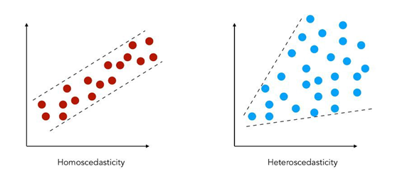
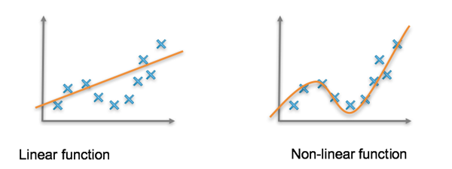
Identified gaps with linear regression :
We found that the data of covid-19 is non-linear, dependence, heteroscedastic. So when we apply the general regression model i.e. Linear Regression then it fails to predict results in this type of data, as the assumptions of linear regressions are violated. So linear regression fails in this predicting results from this type of data and gap is identified.

Slide 15
Analysed need of quantile regression and implemented it
We identified the gaps and to predict the better results we use quantile regression which is a extension of linear regression and is used when the conditions of linear regression is not met like homoscedasticity, linearity, and independence of data. So the quantile regression is able to predict the approximate results for this type of data hence it is used here to predict the approximate results.

Slide 16
Modules
Numpy
NumPy, which stands for Numerical Python, is a library consisting of multidimensional array objects and a collection of routines for processing those arrays. Using NumPy, mathematical and logical operations on arrays can be performed.
Matplotlib
Matplotlib is a powerful library in Python for creating static, animated, and interactive visualizations of data. It is widely used for data visualization in scientific computing, data analysis, and machine learning.

Slide 17
Modules
Statsmodels
Statsmodels is a Python module that provides classes and functions for the estimation of many different statistical models, as well as for conducting statistical tests, and statistical data exploration.
Plotly
Plotly can be used to make a wide variety of charts, including Basic and Statistical charts, Maps, 3D Charts, Subplots, and so on.

Slide 18
Modules
Seaborn
Seaborn is an open source, BSD-licensed Python library providing high level API for visualizing the data using Python programming language.
Pandas
Python with Pandas is used in a wide range of fields including academic and commercial domains including finance, economics, Statistics, analytics, etc.

Slide 19
Outcome
After consolidating the data set about the mortality rates and other covariates for the country, a descriptive statistical analysis and regression modeling is done.
The proposed regression is quite competitive compared with those regressions and provides the best fit according to some selection criteria.
We hope this paper’s findings may improve understanding of coronavirus in India and help the healthcare system better prepare for the advance of the pandemic or even respond to similar epidemics.

Slide 20
References
M.A. Zambrano-Monserrate et al. Indirect effects of COVID-19 on the environment
Sci. Total Environ.
(2020)
A. Razzaq et al. Asymmetric link between environmental pollution and COVID-19 in the top ten affected states of US: a novel estimations from quantile-on-quantile approach
Environ. Res.
(2020)
S. Muhammad et al. COVID-19 pandemic and environmental pollution: a blessing in disguise?
Sci. Total Environ.
(2020)
Y. Ma et al. Effects of temperature variation and humidity on the death of COVID-19 in Wuhan, China
Sci. Total Environ.
(2020)

Slide 21
References
Y. Ma et al. Effects of temperature variation and humidity on the death of COVID-19 in Wuhan, China
Sci. Total Environ.
(2020)
A quantile regression model for bounded responses based on the exponential-geometric distribution
REVSTAT Stat. J., 18 (2020), pp. 415-436
View Record in ScopusGoogle Scholar
Quantile regression models and their applications: a review
J. Biomet. Biostat., 8 (2017), pp. 2155-6180
View Record in ScopusGoogle Scholar
Muccari R, Chow D, Murphy J. Coronavirus timeline: tracking the critical moments of COVID-19. NBCNews. [updated 2020 March; cited 2020 September]. Available from: https://www.nbcnews.com/health/health-news/coronavirus-timeline-tracking-critical-moments-covid-19-n1154341.
World Health Organization [WHO]. Addressing human rights as key to the COVID-19: response, 21 April 2020. [cited 2020 September]. Available from: https://apps.who.int/iris/handle/10665/331811.

Slide 22


